Slide 1
Chapter 2
The Digital Economy

Slide 2
Learning Objectives
Describe the major characteristics of the digital economy
Compare marketplaces with marketspaces
Describe the nature of competition in marketspaces
Describe some economic rules of the digital economy

Slide 3
Learning Objectives (cont.)
Describe the impacts of the digital economy on trading and intermediaries
Describe the impacts of the digital economy on business processes and functional areas in organizations
Understand the role of m-commerce in the digital economy

Slide 4
Opening Case: Rosenbluth International
Threats to international travel agency industry
  Online booking by airlines, hotels, etc.
  Commission caps for agents reduced
  Online companies penetrating corporate market as well as individual travelers
  Competition among major players is rebate-based
  Innovative business models (i.e., name your own price, auctions) embraced by companies in the industry

Slide 5
Rosenbluth International (cont.)
Solution
  Became a purely corporate travel agency
  Rebate customers with entire commission
  Strategic Information Systems
    DACODA: optimizes corporation's travel savings
    E-messaging services: reservation requests and results via e-mail
    E-ticket tracking: deals with and reduces number of unused e-tickets

Slide 6
Rosenbluth International (cont.)
  Strategic Information Systems
    Res-Monitor: low-fare search system, finds additional savings for 1 of 4 reservations
    Global distribution network: enables instant access to traveler’s itinerary, travel preferences, corporate travel policy

Slide 7
Rosenbluth International (cont.)
  Strategic Information Systems (cont.)
    Custom-Res:ensures policy compliance, consistent service, accurate reservations
    IntelliCenters: innovative telecommunications technology was to manage multiple accounts
    Network Operations Center (NOC): monitors weather, current events, air traffic

Slide 8
The Digital Economy
Complete change of business models and strategies for success in digital economy
Web-based IT and EC facilitate competitive advantage
Global competition: price, quality, service

Slide 9
The Digital Economy (cont.)
Extensive networked computing infrastructure is expensive
Web-based applications provide customer service, online selling, and procurement support
Innovative systems must be patented

Slide 10
Digital Economy Defined
Also Known As: Internet economy, new economy, Web economy
Economy based largely on digital technologies
  Digital communication networks (Internet, intranets)
  Computers
  Software
  Related information technologies

Slide 11
Digital Economy Defined (cont.)
Economic revolution
  Unprecedented economic growth (USA)
    IT growth more than doubles that of overall economy
    Provided over ¼ of total economic growth
  Longest period of uninterrupted economic expansion in history
    High-paying jobs
    Very low to negative unemployment in IT industry

Slide 12
Marketspaces vs. Marketplaces
Marketplace: 3 main objectives
  Match buyers and sellers
  Facilitate exchange of information, goods, services, payments (transactions)
  Provide institutional infrastructure enabling efficient functioning of the market
EC in the marketplace
  Increased efficiencies
  Decreased cost of executing business functions

Slide 13
Marketspaces vs. Marketplaces (cont.)
Marketspaces: electronic marketplaces (especially Internet-based)
  Changed processes used in trading and supply chains
  Changes driven by IT
    Increased effectiveness
    Lower transaction and distribution costs
    More efficient markets

Slide 14

Marketspaces vs. Marketplaces (cont.)
Doing business in the real world
  Process raw materials
  Distribute raw materials
Doing business with EC
  Gathering information
  Selecting information
  Synthesizing information
  Distributing information

Slide 15
Components of
Digital Ecosystems
Digital products
  Information and entertainment products
    Paper-based products: books, newspapers, magazines
    Product information: catalogs, training manuals
    Graphics: photographs, maps, calendars
    Video: movies, TV programs
    Software: programs, games, development tools

Slide 16
Components of
Digital Ecosystems (cont.)
  Symbols, tokens, icons
    Tickets and reservations: airline, concert
    Financial instruments: checks, credit cards, electronic currencies
  Processes and services
    Government services: forms, benefits, licenses
    E-messaging: letters, faxes
    Business processes: ordering, inventorying
    Auctions: bidding, bartering
    Others

Slide 17
Components of
Digital Ecosystems (cont.)
Consumers
  Search for detailed information
  Compare products/prices
  Bid or negotiate prices
Sellers
  Innumerable products and services available
  Web sites, marketplaces

Slide 18
Components of
Digital Ecosystems (cont.)
Intermediaries
  Create and manage online markets
  Match buyers and sellers
  Provide infrastructure services
  Aid transactions
Support services: address implementation issues
  Certification and trust services
  Knowledge providers

Slide 19
Components of
Digital Ecosystems (cont.)
Infrastructure companies: provide hardware, software, EC support
Content creators: create and maintain Web sites
Business partners: Internet collaboration usually along the supply chain

Slide 20
Components of
Digital Ecosystems (cont.)
Electronic marketplaces
  Exchanges—many-to-many
  Sell-side—one-seller-many-buyers
  Buy-side—one-buyer-many-sellers
  Public—open to all
  Private—open to invited traders only

Slide 21
Competition in Marketspaces
Competition in the Internet ecosystem (business model of the online economy)
  Inclusive with low barriers to entry
  Self-organizing
  Old rules may no longer apply
Competition is tense
  Lower buyers’ search cost
  Speedy comparisons
  Differentiation and personalization

Slide 22
Competition in Marketspaces (cont.)
Consumers like differentiation and personalization
  Lower prices
  Customer service
Size of company no longer significant
Geographical location insignificant
Language barriers are being removed
Digital products do not have normal wear and tear

Slide 23
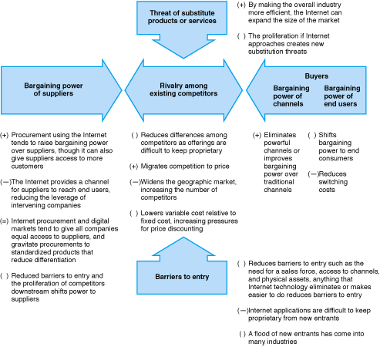
Figure 2-1
Porter’s Competitive Analysis
Source: Reprinted with the permission of the Free Press, a Division of Simon & Schuster, Inc. , from Competitive Advantage: Creating and Sustaining Superior Performance by Michael E. Porter, p. 67. Copyright © 1985, 1998 by Michael E. Porter.

Slide 24
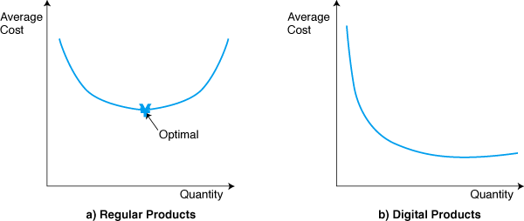
Figure 2-2
Cost Curve of Regular and Digital Products
Cost curves
Bundling products/services
Buying vs. renting

Slide 25
Issues and Success Factors (cont.)
Critical Mass of Buyers & Sellers
  High fixed costs of deploying EC
  Market efficiency
  Development of strong, fair competition
Quality uncertainty and quality assurance
  Provide free samples
  Return if not satisfied

Slide 26
Issues and Success Factors (cont.)
Pricing on the Internet
  Determines: sales volume, market share, product profitability
  Price discrimination: different prices to different buyers through customization of products
  Product differentiation: price based on value to the customer, not cost of production

Slide 27
Issues and Success Factors (cont.)
Online vs. off-line pricing
  Click-and-mortar—available online and off-line
  Brokerage houses—50% commission discount for online trades
Economic Impacts of EC
  Production function—can substitute capital for labor for same quantity of production
  Lower the labor needed, higher required investments
  EC lowers amount of labor/capital needed to produce the product

Slide 28
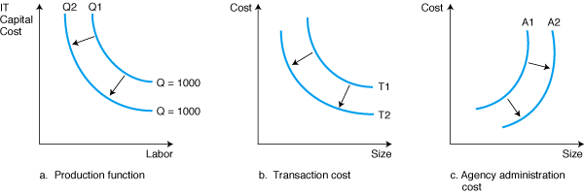
Figure 2-3
Economic Effects of EC

Slide 29
Issues and Success Factors (cont.)
Contributors to E-market success
  Product characteristics
    Type: digitized, non-digitized
    Price
    Standards and product information available allows sale of most items: cars, computers, groceries
  Industry characteristics
    Brokers currently necessary
    Intelligent systems may replace brokers

Slide 30
Issues and Success Factors (cont.)
  Seller characteristics
    Consumers find sellers with the lowest prices
    Low-volume, higher-profit-margin transactions
  Consumer characteristics
    Impulse buyers
    Patient buyers
    Analytical buyers

Slide 31
Impacts on Trading Processes and Intermediaries
Industry structure
  Consumers are aware of competitor’s prices through searches; intermediaries become obsolete
  Digitization of more products; reduction in shipping costs
  Seller and customer activities converge in 1 place
    Marketing
    Order processing
    Distribution
    Payments
    Product development

Slide 32
Impacts on Trading Processes and Intermediaries (cont.)
Industry structure (cont.)
  Roles and value of intermediaries in e-markets
    Search costs: brokers with access to customer preferences can predict demand for products
    Lack of privacy: anonymity of buyer and/or seller
    Incomplete information: gathers product information from many sources
    Contracting risk
    Pricing inefficiencies

Slide 33
Impacts on Trading Processes and Intermediaries (cont.)
Industry structure (cont.)
  Disintermediation and reintermediation
    Disintermediaries: match and provide information
    Reintermediatiaries: provide value-added services (consulting)
  Syndication: sale of the same good to many customers, who integrate it with other offerings and redistribute it (virtual stock brokers)

Slide 34
Impacts on Trading Processes and Intermediaries (cont.)
Syndication supply chain
  Syndication of information is critical to the success of EC
  Distributors provide free information to consumers, and package and sell the same information
  Content creators sell the same information to many syndicators and distributors

Slide 35

Figure 2-5
The Supply Chain of Syndication

Slide 36
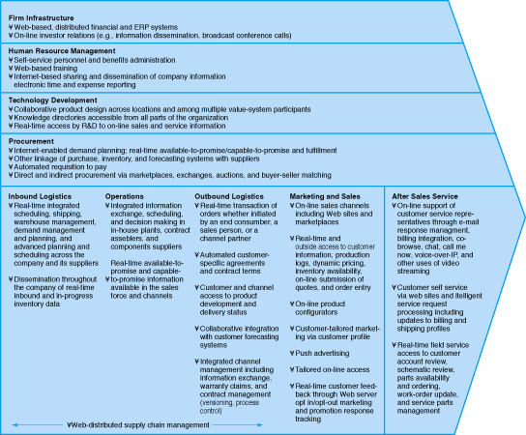
Figure 2-6
The Analysis Framework
Insert Fig 2-6 here
Source: Block and Segev (1996). Reproduced with permission of the authors.

Slide 37
Impacts on Trading Processes and Intermediaries (cont.)
Potential Winners and Losers in EC
  Winners
    Internet access providers
    Diversified portal service providers
    EC software companies
    Proprietary network owners
    Others

Slide 38
Impacts on Trading Processes and Intermediaries (cont.)
Winners in EC
  Internet access providers
  Diversified portal service providers
  EC software companies
  Proprietary network owners
  Others
Losers in EC
  Wholesalers (particularly small ones)
  Brokers
  Salespeople
  Nondifferentiated manufacturers

Slide 39
Impact on Business Processes and Organizations
Improving direct marketing
  Product promotion
  New sales channels
  Direct savings
  Reduced cycle time
  Customer service
  Brand or corporate image

Slide 40
Impact on Business Processes and Organizations (cont.)
Other marketing-related impacts
  Customization
  Advertising
  Ordering systems
  Markets
Transforming organizations
  Technology and organization learning
  Changing nature of work

Slide 41
Impact on Business Processes and Organizations (cont.)
Redefining organizations
  New product capabilities
  New business models
Impacts on manufacturing
  Build-to-order
Impact on finance and accounting
Human resource management, training, and education

Slide 42

Mobile Commerce
Applications of M-commerce
  Online stock trading
  Online banking
  Micropayments
  Online gambling
  Ordering and service
  Online auctions
  Others

Slide 43
Mobile Commerce (cont.)
A successful vendor
  I-mode customers can
    Receive train timetable
    Discount coupons for shopping and restaurants
    Purchase music online
    Send or receive photos
    Purchase airline tickets
    Locate information about books and buy them

Slide 44
Managerial Issues
New business models
Competition in the digital economy
How to transform to digital economy
Disintermediation and reintermediation
Going global
Organizational changes
Alliances

